Slide 1
Computer Crimes: Part I
By Alex, Thomas and Kyle

Slide 2



Self-Introduction
Alex - ENTJ
Kyle - ESTP
Thomas - INTP

Slide 3
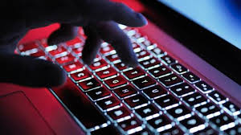
Hacking
The intentional and unauthorized access to computer systems
May steal money, information, release viruses, crash websites, destroy files

Slide 4
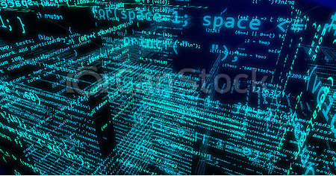
Background info
-To make a comparison, A robber who enters a bank and uses a gun will get $2,500–$5000 on average. The average loss from a computer fraud is more than $100,000.
-IRS reported that thieves have stolen personal information from more than 300,000 tax returns stored in IRS database
-Hackers in Ukraine broke into news services where they had access to information about corporate earnings before the information was public, this info was used to make valuable stock trades
-Crimes in cyberspace affect millions of people and have costed billions of dollars

Slide 5
Three Eras of Hacking
Era 1: 1960s and 1970s, hacking was a positive term
Era 2: From the late 1970s to the late 1990s, hacking started getting more negative connotations
Era 3: 1990s to today, with the exponential growth of the web and all other technology hacking has become more dangerous than before

Slide 6

Era 1
-Hackers were considered very clever, basically looked up at, they wrote the first computer games and operating systems
-They sometimes found ways into systems they weren't authorized for but their main intention was to seek out intellectual challenges
-Jude Milhon described hacking as "clever circumcision of imposed limits" where a high level of skill is needed
-Is there an occasion where hacking would be ethical? How can it be helpful for companies to have hackers working with them?

Slide 7
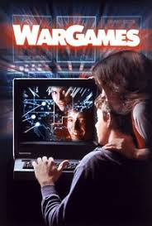
Era 2
-Computers are becoming more widespread, so people are finding ways to abuse them
-Hackers wanted bigger challenges such as hacking a computer at a big research center, corporation or government agency. It also gave them more respect in the hacking community
-The movie "War Games" inspired many young hackers to break into Defense Department computers.
-Should the movie be held responsible for advocating hacking and making it seem "cool"?
-Computer program known as Internet Worm released by Cornell graduate student slowed down many computers and disrupted people's work

Slide 8
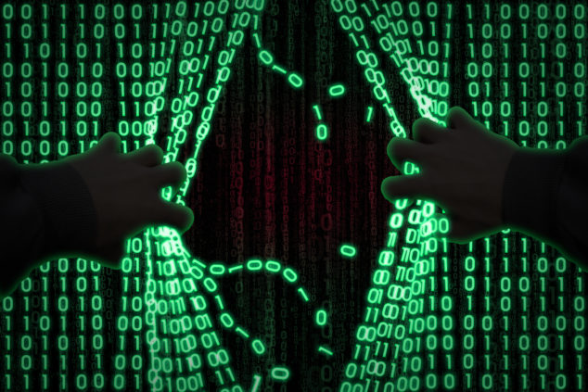
Era 3
-Businesses and governments began to move everything online creating a huge explosion of information
-Multiple viruses began emerging that destroyed files, collected passwords and caused email servers to shut down
-A teenager was able to cripple a computer system handling communications between an airport tower and incoming planes
-Hackers started doing revenge attacks, which essentially were attacks on governments for shutting down certain illegal websites (such as pirated music and show sites) or they were attacks on businesses for suing them (Sony sued George Hotz for showing how to run unauthorized apps on the PlayStation 3, Hotz and other hackers then retaliated by accessing personal information of many PlayStation users)
-Can these attacks be justified? Are they ethical? When would they be justified?

Slide 9
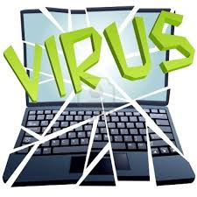
Definitions
-Virus: software that attaches or adds itself to other software, it can replace itself and perform other functions
-Worm: gains access to host system and then scans nearby systems for flaws so it can exploit them
-Trojan horse: just as the name appears; it seems like a regular application but it has malicious component to it
-Social engineering: manipulating people into releasing information or performing a task that breaks security protocols, often can be done by impersonation
-Phishing: sending out millions of messages fishing for information that can be used to steal money and goods (ex: fake email from IRS saying they have a tax refund for you if you provide them more information)

Slide 10
Definitions continued
-Pharming: luring people on to fake websites where thieves can easily collect their personal data
-Ransomeware: a type of malware that encrypts files on a device (mobile phone, computer, tablet) and then it shows a message that demands money for the files to be decrypted
-Spyware: malware that can monitor and record user activities on a computer or mobile device. This includes anything from keeping track of keyboard inputs, passwords, usernames but it may include controlling a webcam. Cassidy Wolf, a winner of Miss Teen USA 2013, was the target of this when one of her classmates purchased spyware which let him watch her and take pictures of her through the webcam
-Botnet: a group of computers or devices (referred to as zombies) that contain a virus which communicates with the central host or server controlled by a hacker. It's a "coordinated army of compromised devices" as put by Sean Gallangher.

Slide 11
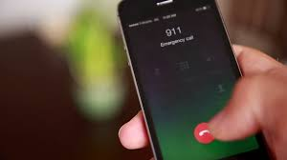
Definitions continued
-Denial of service attack: an attack where a botnet overwhelms websites, mail servers, and other internet locations with a large amount of requests so that normal users can't have access to the sites. An example of this would be when a DSA activated malware on smartphones which caused them all to call 911 and slowed down the response time for actual emergency callers. Other sites such as PayPal, Netflix, Reddit and GitHub have been disturbed by these attacks

Slide 12
Harmless Hacking
-Can hacking ever be harmless? What if there's no bad intent? What are some unexpected consequences of gaining access to an unauthorized system?

Slide 13
"Harmless Hacking"
-No matter how harmless, when a system administrator registers that some unknown user has access to their serves, they need to expend time, energy and resources into investigating that and shutting them down. Companies and government systems may spend a large amount of money verifying that the intruder didn't change any files
-There is always uncertainty about the hacker's intent, and uncertainty causes harm
-A hacker with good intentions may make a mistake which does significant damage

Slide 14
Facebook: personal info of users being compromised
-New York (CNN): Almost 30 million Facebook users' phone numbers and email addresses were accessed by hackers in the biggest security breach in the company's history, Facebook said Friday.
-The company said that it may still not know the full extent of the attack and wasn't ruling out the possibility of other "smaller-scale attacks" linked to the breach. The company said it will continue to investigate "other ways the people behind this attack used Facebook."
-This investigation has been ongoing for two weeks already
https://www.cnn.com/2018/10/12/tech/facebook-hack-personal-information-accessed/index.html

Slide 15
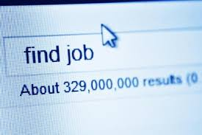
Specific Applications of Hacking
Convenience and efficiency engender risks:
Identity is now essentially a series of numbers (SSN, debit/credit card #s, zip code, etc.)
Hackers love job-hunting sites (resumes)
Identity theft (credit & debit fraud), regardless of scale
In the US, total loss amounts to tens of billions per year
Notes:
Identity theft: activity in which a criminal / organization uses the identity of an unknowing innocent person
Banking, investing could all be done online

Slide 16
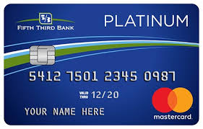
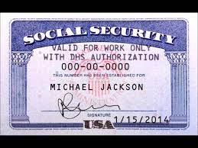
Consequences
Victims might lose good credit rating → unable to borrow money, pay rent, get a job, etc.
Credit card companies usually bear the cost of credit card fraud, but those losses lead to higher charges for the consumer

Slide 17
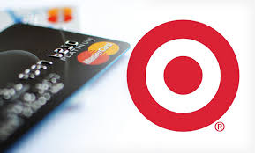
The Target Breach
Four weeks in 2013
Access to 40 million credit card numbers and 70 million names, addresses, and phone #s
How?

Slide 18

The Target Breach
1. Phishing email to an employee at Fazio Mechanical (125 employees total, heating & a.c. maintenance)
2. Citadel Trojan → access to internal information through vendor portal
3. Internal networks servers had weak passwords → 70 million names and addresses
4. POS (point-of-sale) system misconfiguration
5. Transferred BlackPOS to Target’s network and installed it on Target’s POS workstation
6. Sent information to internal server using administrator privileges → 40 million credit cards

Slide 19
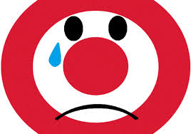
The Target Breach - Aftermath
Hackers sold each credit card data for an average of $27 dollars
3%~7% of the card numbers were used before banks realized
Estimated take by hackers ~$53.7 Million
46% Drop in profits for the quarter for Target
$200 million to reissue credit for half the compromised accounts

Slide 20
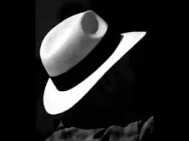
The Target Breach - Question
Would the hackers’ actions be justified if they informed Target about the security loophole and didn't steal anything?

Slide 21
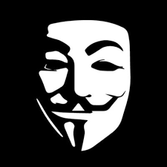
Hacktivism
Def: Use of hacking to promote a political cause
Examples:
Tweaked Department of Justice Web Page to protest against CDA
Three teens hacked into the network of an atomic research center in India to protest against nuclear weapons testing
Hacktivists target China and Indonesia for anti-democratic policies

Slide 22
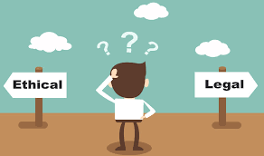
Hacktivism - Questions
Is there ethical justification for hacking in those cases?
Should penalties for hacktivists be different from that of other hackers?
Notes:
It’s hard to define who is an “activist” because it depends entirely on political perspective.

Slide 23

Hacktivism - Perspective
Hard to distinguish between an ‘activist’ and a ‘criminal’. Ethicality of such actions are highly debatable.
Deontological View might state that political hacking is no more justified than normal hacking.
On the contrary, some argue that political hacking is ‘civil disobedience’ in the modern world.
Traditionally respected and nonviolent (often cite Gandhi, MLK Jr. as notable role models)
Hacktivism is probably most ethically justified in nations where civil disobedience is least likely to be respected
Notes:
Depends entirely on political perspective
Is a pro-drug message n a police website a political statement against drug policies in the US or is it just an act of a kid showing off?
What about a religious group shutting down a website designed for the LGBTQ community?
Precise downfall of utilitarinis ethics

Slide 24
Hacking by Government
Hacking by governments has increased drastically, and are usually for economic and military espionage and to disable (future) enemies.
Examples:
Chinese Hackers retrieving terabytes of information from the Pentagon (through Phishing)
International Hackers in China had access to the computer system of a U.S. telecommunications company for 10 years

Slide 25
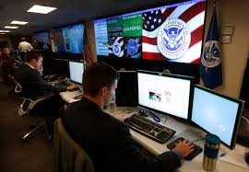
Hacking by Government
Goes beyond just informations systems:
Russian & Chinese hackers left code in U.S. Electric power grid
U.S. Justice department charged Iranian hackers for breaking into control systems of a small dam north of New York
Stuxnet - Joint effort between U.S. and Israel to sabotage centrifuges used by Iran to enrich uranium
Leaked NSA documents show that U.S. manufactured communications gear (routers) have been modified for spying conveniences

Slide 26
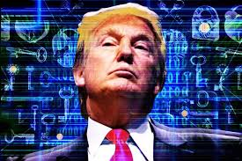
Cyber Warfare?
Pentagon announced that the U.S. will treat cyber attacks as acts of war and respond with military force.
When would a cyber attack be justified? Then, is Stuxnet justified?
When is a cyber attack an actual act of war?

Slide 27
The Vulnerability of the Digital World

Slide 28

Why is the digital world so vulnerable?
Why do hackers seem to easily get access to our friends’ contact lists and send us spam?
Our new tools are powerful, but remarkably vulnerable.
Factors that contribute to these vulnerabilities
Complexity of computers
The speed of development
Economics, business, and politics
Human nature.

Slide 29

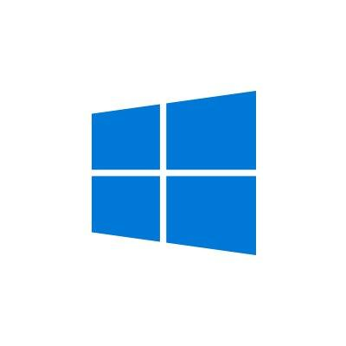
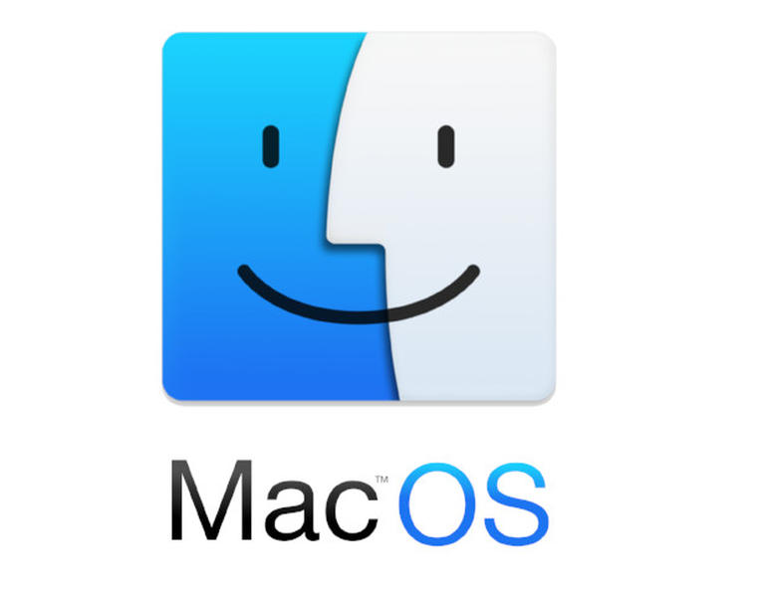
Vulnerability of Operating Systems
Operating systems are complex
Various updates/patches occur to fix previous bugs and errors
Systems that were secure once may become vulnerable later
Automatic updates angered certain people
How would you feel if your personal OS was updating automatically without your consent?
Notes:
OS systems: apple MacOS, Windows, Linux all aim to balance
-as many features as possible
-the ability to control as many features
-convenience and ease of use
-providing a stable cash-free system
-providing a secure system
Balancing all of this requires thousands of developers

Slide 30
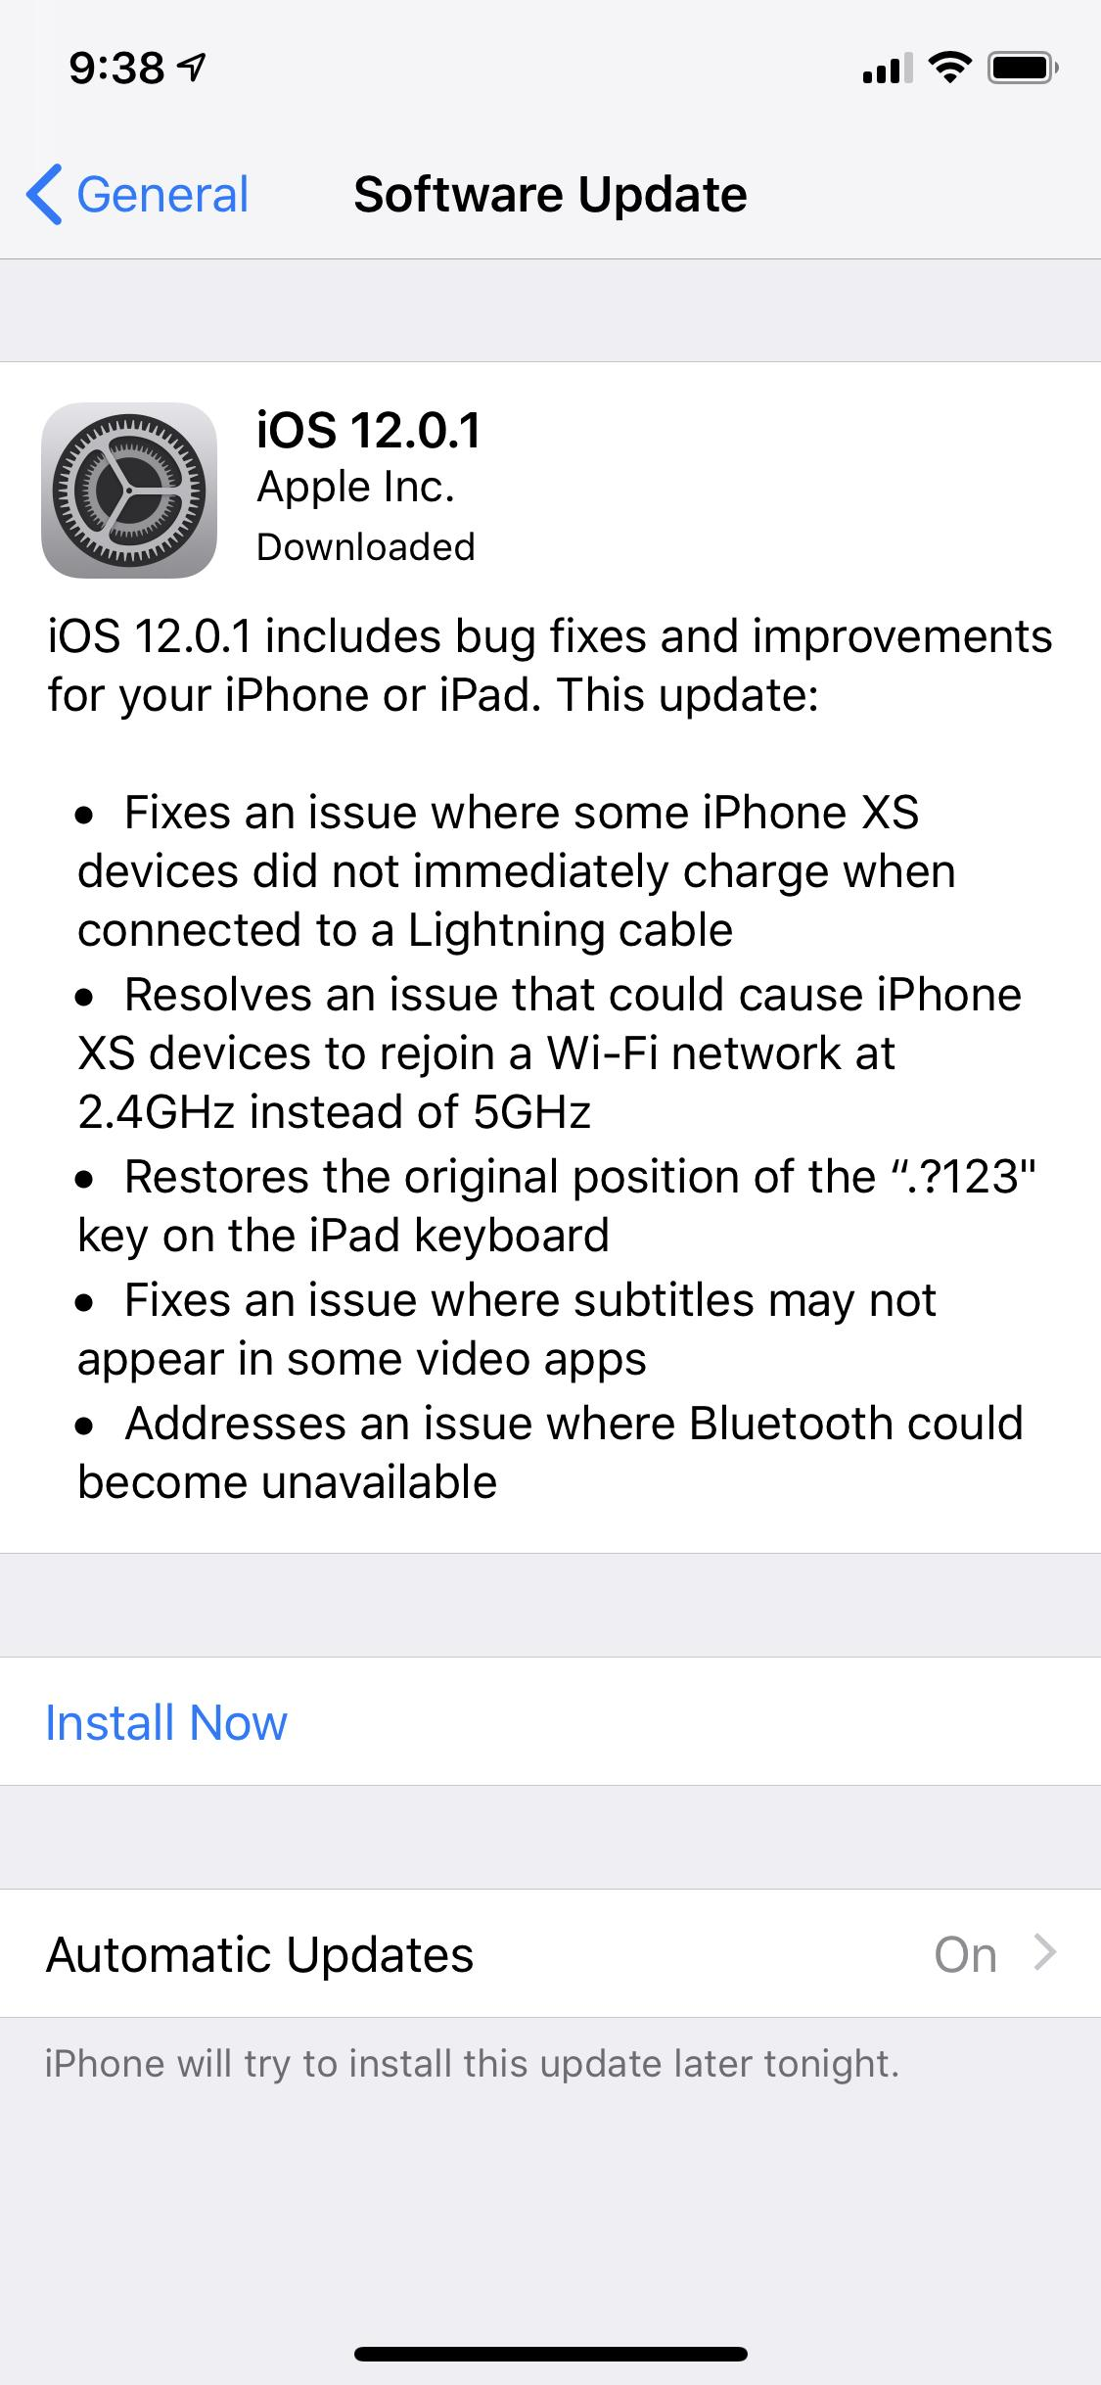
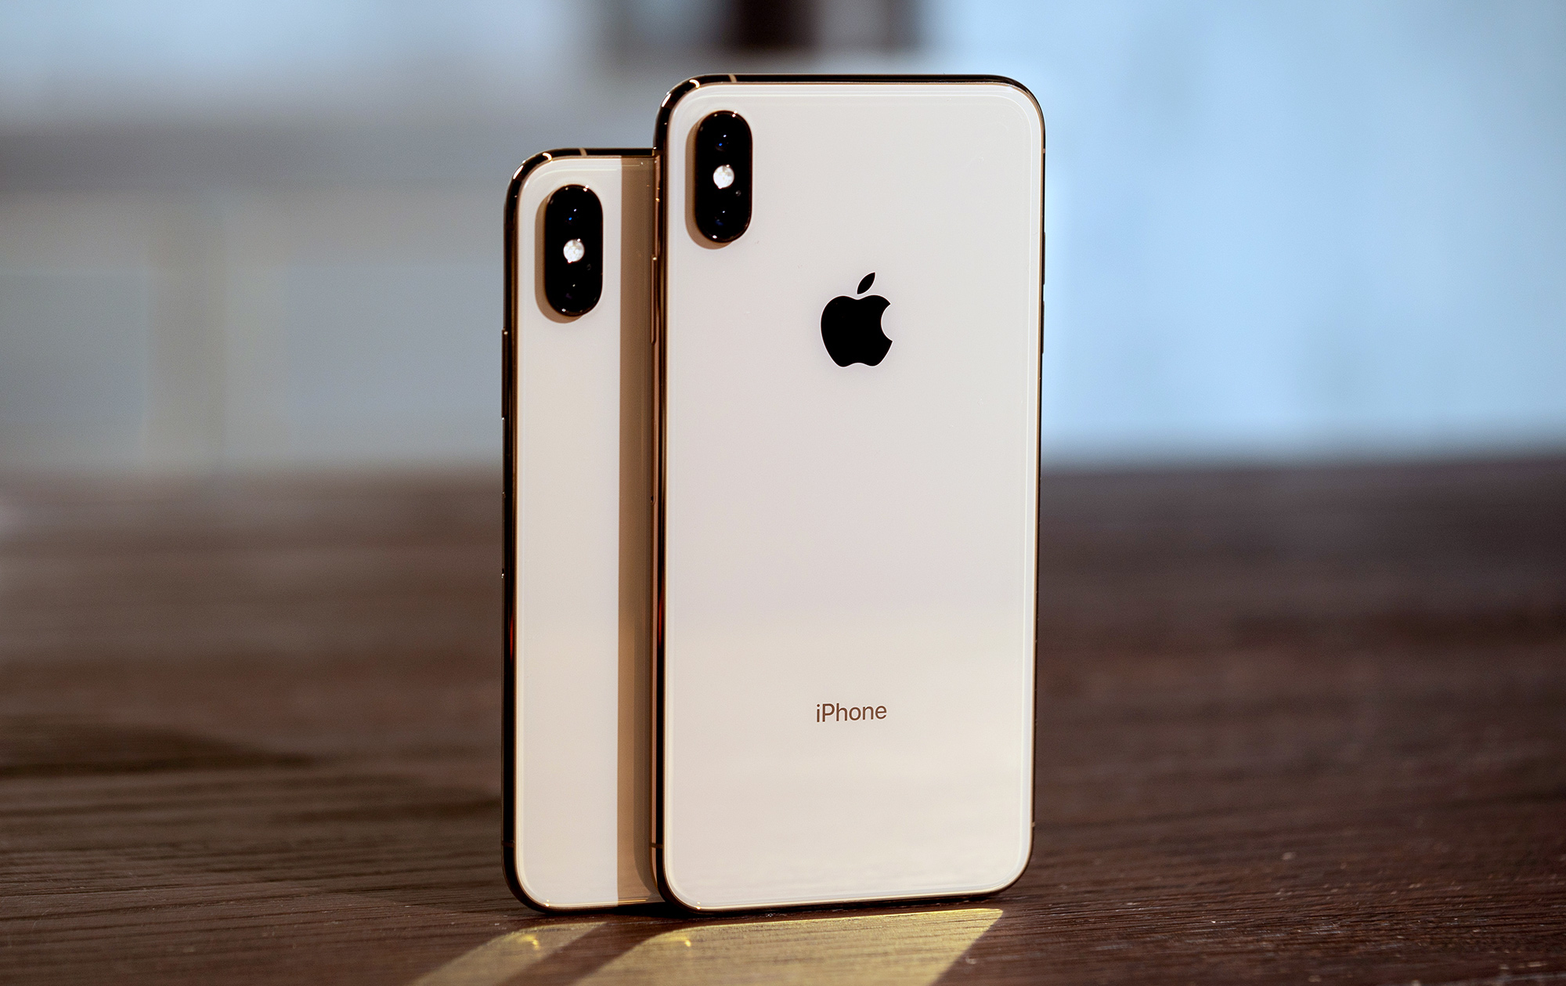
Chargegate? (2018)
-Apple’s new iPhone XS Plus would not begin charging unless the screen was on
-This was a bug that needed a patch to fix...

Slide 31
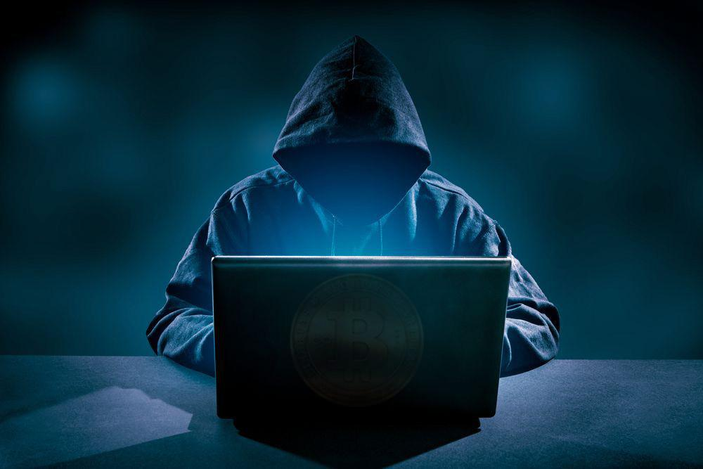
Vulnerability of the Internet
Internet was first ARPANET: linking together universities, tech companies, and government installations
Internet security depended on trust.
Dan Farmer (1996) discovered 1100 out of 1700 sites had security weaknesses
His warnings had little effect
Even today in 2018, most small businesses have no IT department or training on how to protect themselves from hackers or malware
Hackers start small and then go big
Notes:
Company websites that preach “There is nothing valuable here, why worry about security?” are prime targets for hackers
-Hackers set up identical websites like these and can be able to phishing scams, pharming or other malicious purposes

Slide 32
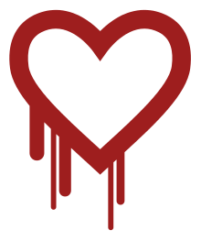
The Heartbleed Bug (2014)
One of the largest security breaches
Found in the free operating system OpenSSL
In 2014, almost two-thirds of the Internet relied on this software for security
Called the “Heartbleed” because the bug was located in the “heartbeat” section of OpenSSL
Web-based companies began to increase funding to support OpenSSL

Slide 33
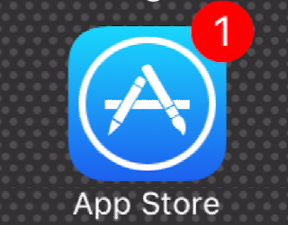
Human Nature, Markets, and Vulnerability
Humans want new things fast
Rapid development increases Baase and Henry’s (2018) “Internet of Things”
Competition has made companies release new apps at a pace that is unsecure
A class competition:
Who thinks they have the most gaming apps on their phone?
What might that represent?
Who thinks they have the most apps needed to be updated?

Slide 34

Human Nature, Markets, and Vulnerability
Technology is expanding -
A hypothetical, but a scary one…
Imagine an older man has a pacemaker put into his body, what is stopping a criminal from hacking into that pacemaker and killing the man?
The FDA is regularly issuing safety alerts for medical devices but…
Is that enough? Should these medical devices be put through extensive tests before they go onto the market?

Slide 35
End of presentation

